Slide 1

Ring of FHIR Overview
CT Medication Reconciliation Hackathon
Courtney Delgoffe and Matt Englehart
4/5/19

Slide 2

Ring of FHIR® Overview
Composed of:
18 FHIR PIT’s - servers that represent real world healthcare organizations
Active Care Relationship Server (ACRS) that maps patient provider attributions
A Health Directory Server that lists endpoints for healthcare practitioners
A “FHIR Station” query broker
All FHIR PIT’s are populated with synthetic healthcare data
Each FHIR PIT has a unique RESTful end point and a simple web user interface
Each FHIR PIT is secured with basic authentication
Pharmacy 1
ACO EHR 1
PO EHR 1
Pharmacy 2
ACO EHR 2
PO EHR 2
Pharmacy 3
ACO EHR 3
PO EHR 3
Payer 1
HIE 1
FHIR Station
Payer 2
HIE 2
HD
Payer 3
HIE 3
ACRS
Payer 4
CQF Ruler PIT
Payer 5
Copyright 2019 Velatura LLC.
CONFIDENTIAL – PROPRIETARY - RESTRICTED

Slide 3
Synthetic FHIR Resources
Synthetic FHIR resources are mapped to FHIR PIT’s based on the FHIR PIT’s function (e.g. EHR, Payer, HD, ACRS, etc.)
Observation
Encounter
Procedure
Immunization
MedicationRequest
MedicationStatement
Condition
CarePlan
Diagnostic Report
Person
Patient
AllergyIntolerance
ImagingStudy
Organization
Endpoint
Practitioner
PractitionerRole
Basic
Contract
Location
Medication
Copyright 2019 Velatura LLC.
CONFIDENTIAL – PROPRIETARY - RESTRICTED

Slide 4
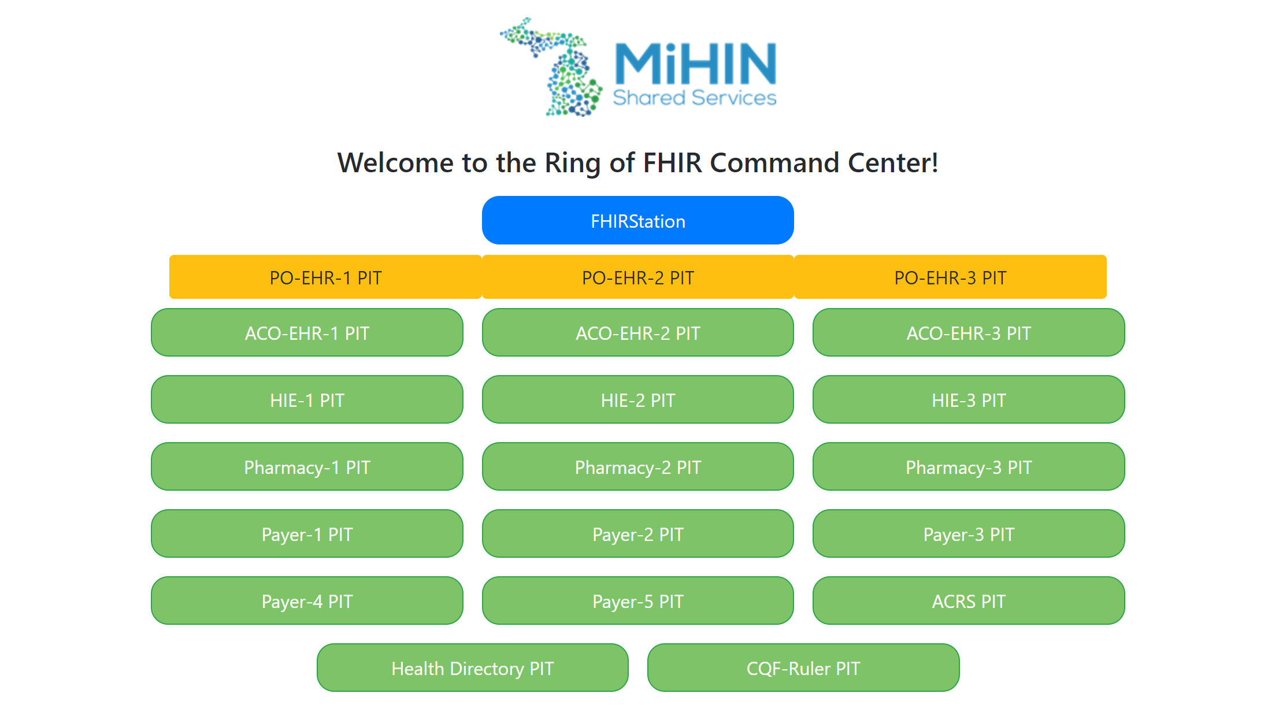
Step 1 - Getting Started
Visit the Ring of FHIR Command Center in your browser to view a clickable list of all FHIR PIT’s in the Ring. The URL of the Command Center is - https://fire-pit.mihin.org/FHIRCommandCenter/
Click the “ACRS PIT” button to navigate to the ACRS PIT web UI.
Ring of FHIR Command Center
Copyright 2019 Velatura LLC.
CONFIDENTIAL – PROPRIETARY - RESTRICTED

Slide 5
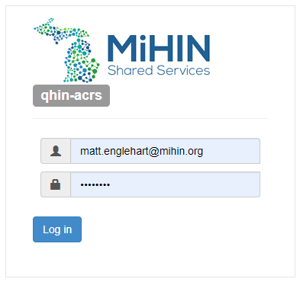
Step 2 – Log In
Sign on to the ACRS PIT using the user name and password provided prior to the event.
Copyright 2019 Velatura LLC.
CONFIDENTIAL – PROPRIETARY - RESTRICTED

Slide 6
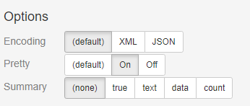
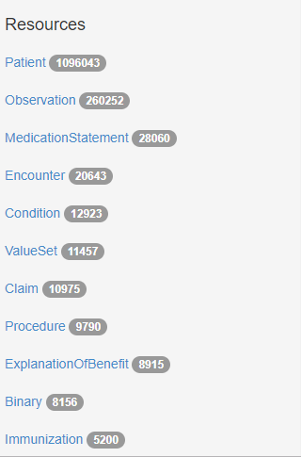

Step 3 – Explore the Web UI
1
2
Set options according to your preference
View the resources types and counts available on the server
View the servers conformance or capability statement
3
Copyright 2019 Velatura LLC.
CONFIDENTIAL – PROPRIETARY - RESTRICTED

Slide 7
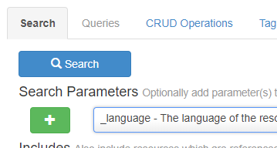
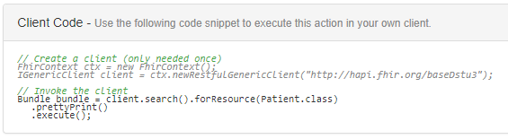
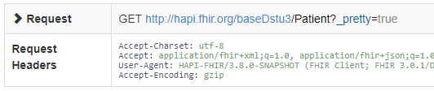
Step 4 – A Simple Query
Click “Patient” in the left rail “Resources” menu
Click “Search” to return a Bundle of Patient resources from the server
View the generated HAPI FHIR java client code
View the GET URL to return all Patient resources on the server - https://fire-pit.mihin.org/qhin-acrs/baseDstu3/Patient
1
2
3
4
Copyright 2019 Velatura LLC.
CONFIDENTIAL – PROPRIETARY - RESTRICTED

Slide 8
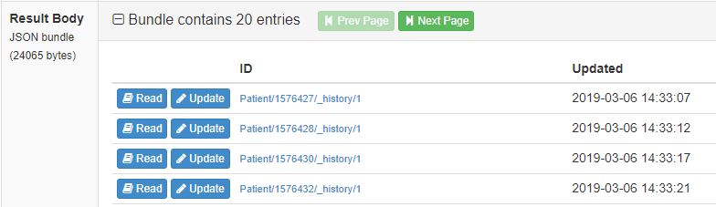
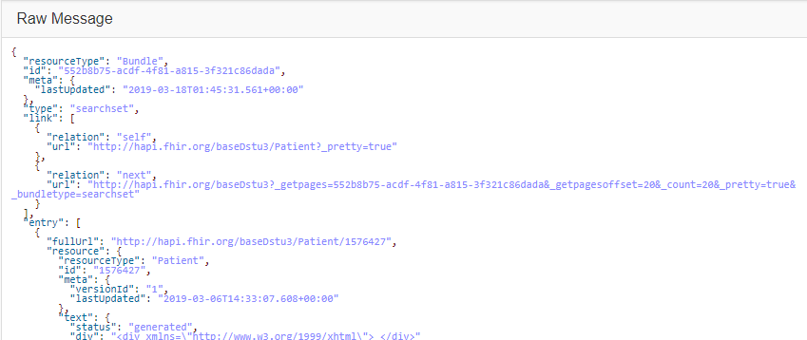
Step 4 Continued – A Simple Query
View the resources returned in the response bundle
View the raw message body content
Click “Read” next to a Patient in the “Result Body” section
1
3
2
Copyright 2019 Velatura LLC.
CONFIDENTIAL – PROPRIETARY - RESTRICTED

Slide 9
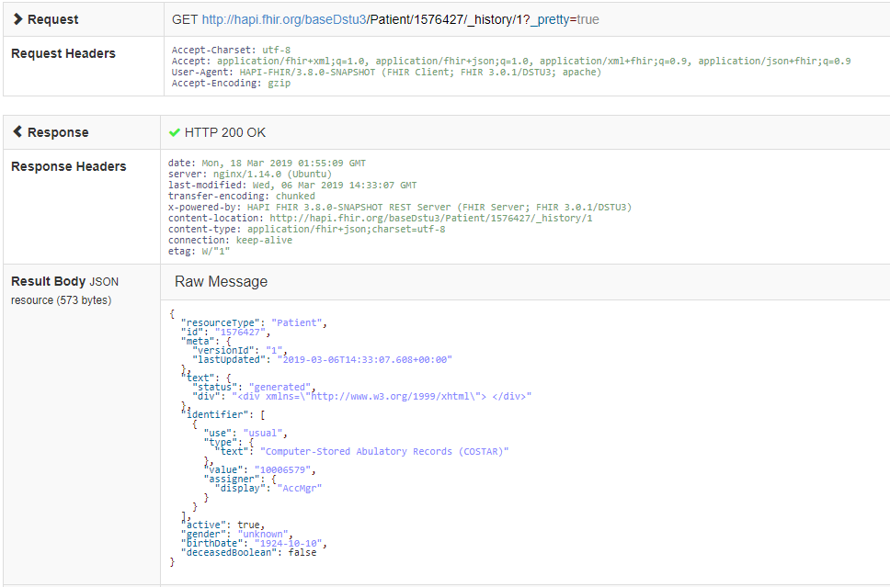
Step 4 Continued – A Simple Query
1
View the GET URL to return a specific Patient resource on the server - https://fire-pit.mihin.org/qhin-acrs/baseDstu3/Patient/318
View the raw message body content
2
Copyright 2019 Velatura LLC.
CONFIDENTIAL – PROPRIETARY - RESTRICTED

Slide 10
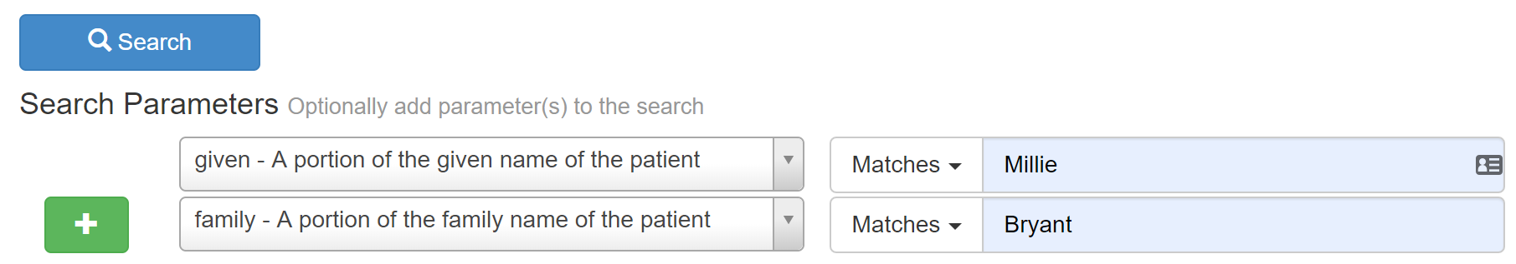
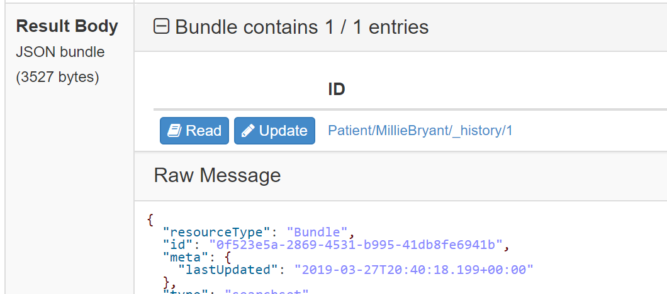
Step 5 – A More Advanced Query
Return to FHIR Command Center and select PO-EHR-2 PIT
Click “Patient” in the left rail “Resources” menu
Click “Given” and enter “Millie” in the search field.
Click the + button and add “Family” to search criteria and enter “Bryant” in search field.
Click “Search” to return a Patient resources from the server.
Click “Read” next to a Patient in the “Result Body” section.
View the GET URL to return Patient resources on the server –
https://fire-pit.mihin.org/po-ehr-2/baseDstu3/Patient?given=Millie&family=Bryant&_pretty=true
1
4
2
3
5
Copyright 2019 Velatura LLC.
CONFIDENTIAL – PROPRIETARY - RESTRICTED

Slide 11
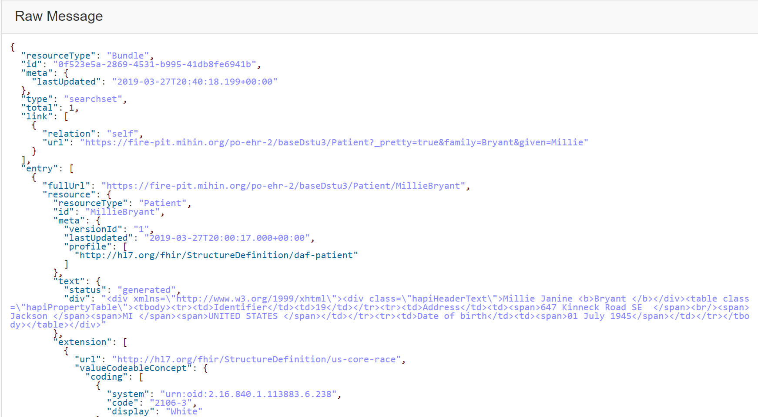

Step 5 Continued – Advanced Query
In the Raw Message section there will be more information about the Patient
Look for “Patient ID” - this can be used to search for more information on the Patient
a. ID: “MillieBryant”
1
2
Copyright 2019 Velatura LLC.
CONFIDENTIAL – PROPRIETARY - RESTRICTED

Slide 12
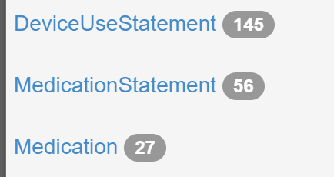
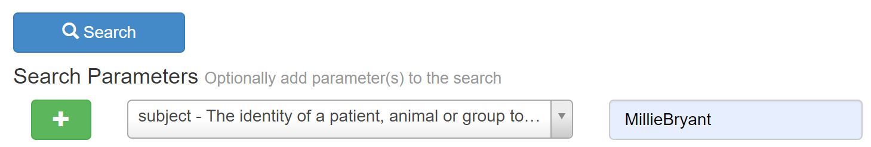
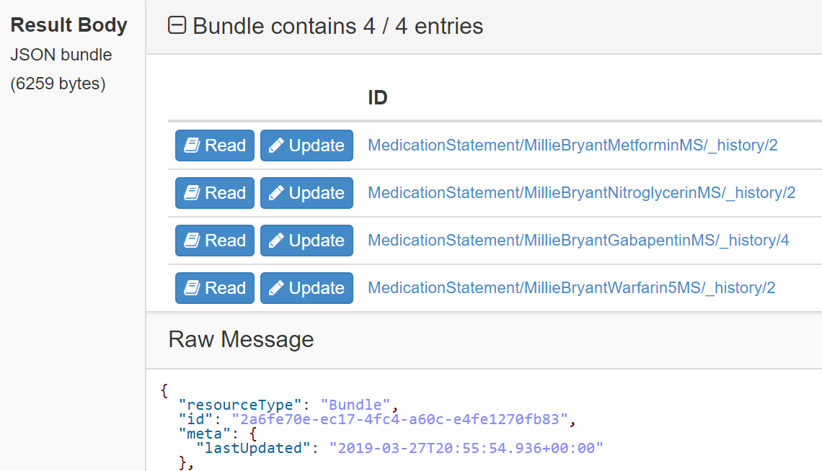
Step 6 – Find MedicationStatement
Click “MedicationStatement” in the left rail “Resources” menu
Click “Subject” and enter Patient Name – “MillieBryant”
Click “Search” to return a Bundle of MedicationStatement resources from the server.
Click “Read” next to a MedicationStatement in the “Result Body” section.
View the generated HAPI FHIR java client code.
View the GET URL to return all Patient resources on the server –
https://fire-pit.mihin.org/po-ehr-2/baseDstu3/MedicationStatement?subject=MillieBryant&_pretty=true
1
3
2
4
5
Copyright 2019 Velatura LLC.
CONFIDENTIAL – PROPRIETARY - RESTRICTED

Slide 13
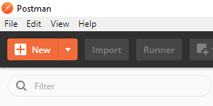
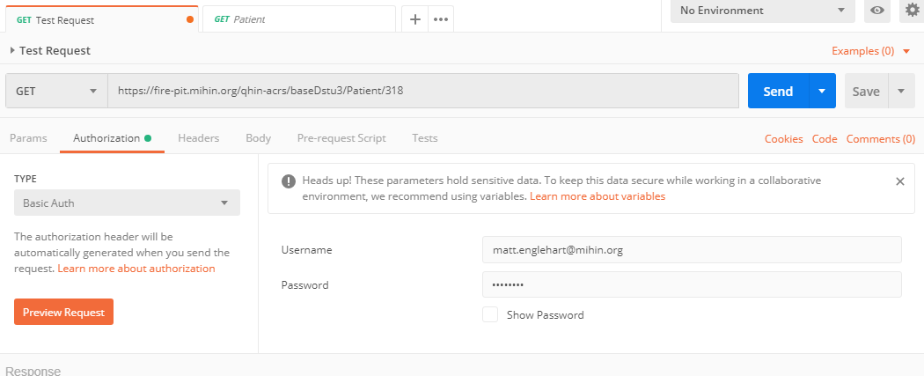
Try it with Postman
Download Postman - https://www.getpostman.com/downloads/
Click the down arrow on the orange “New” button and select “Request”
Create a request name like “Test Request”
Click “Save”
Select “Get” and copy the following URL into the “Enter request URL” input box - https://fire-pit.mihin.org/qhin-acrs/baseDstu3/Patient/318
Click “Authorization” then select “Basic Auth” from the “Type” dropdown menu
Enter your user name and password on the right
Click “Save”
Click “Send”
1
8
7
4
5
6
Copyright 2019 Velatura LLC.
CONFIDENTIAL – PROPRIETARY - RESTRICTED

Slide 14
Ring of FHIR URL’s
EHR 1 (Golden Record)
https://fire-pit.mihin.org/po-ehr-1/user-login
EHR 2
https://fire-pit.mihin.org/po-ehr-2/user-login
EHR 3
https://fire-pit.mihin.org/po-ehr-3/user-login
Copyright 2019 Velatura LLC.
CONFIDENTIAL – PROPRIETARY - RESTRICTED

Slide 15





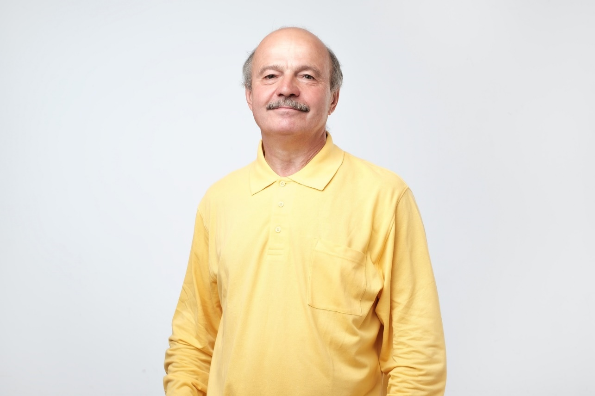
Med Rec Personas
Millie Bryant
George Tullison
Sarah Thompson
Christy Munson
Alex Gonzales
Santiago Morales
Copyright 2019 Velatura LLC.
CONFIDENTIAL – PROPRIETARY - RESTRICTED

Slide 16
Hackathon Activity
Each of the Personas represent a Medication Reconciliation scenario that needs to be performed. Participants should identify the issue with each Persona and propose a solution(s) for Medication Reconciliation leveraging the available FHIR resources. We encourage participants to leverage all the Personas included and identify which of the following scenario(s) they match with:
Duplication of same medication
Duplication of generic and brand name medication
Missing medications
Negative Drug Interaction
Conflicting medication records
Complex medication management
Copyright 2019 Velatura LLC.
CONFIDENTIAL – PROPRIETARY - RESTRICTED

Slide 17
Thank you!
Contact Information
Matt Englehart
matt.englehart@mihin.org
Courtney Delgoffe
courtney.delgoffe@velatura.org
Copyright 2019 Velatura LLC.
CONFIDENTIAL – PROPRIETARY - RESTRICTED

